Slide 1
Col1GFP Bulk RNAseq
DEG analysis

Slide 2
Upregulated

Slide 3
Total Upregulated Gene List
SPEF1
NAV3
ATXN7
TAOK1
FOXC1
SEMA6A
SERPINE1
HIPK1
RUNX1
SPRED1
ADAMTS1
AGO2
STAB1
ANGPTL4
EPHA1
S100A9
S100A8
USP7
HNRNPAB
CSRP3
PIEZO1
CLN3
MYCBP2
SHANK1
TBX1
MYF6
SIX2
CREBBP
LRG1
EP300
RNF111
HIPK2
BMPR2
FOXF1
NF1
PKD2
TBX2

Slide 4
Results

Slide 5
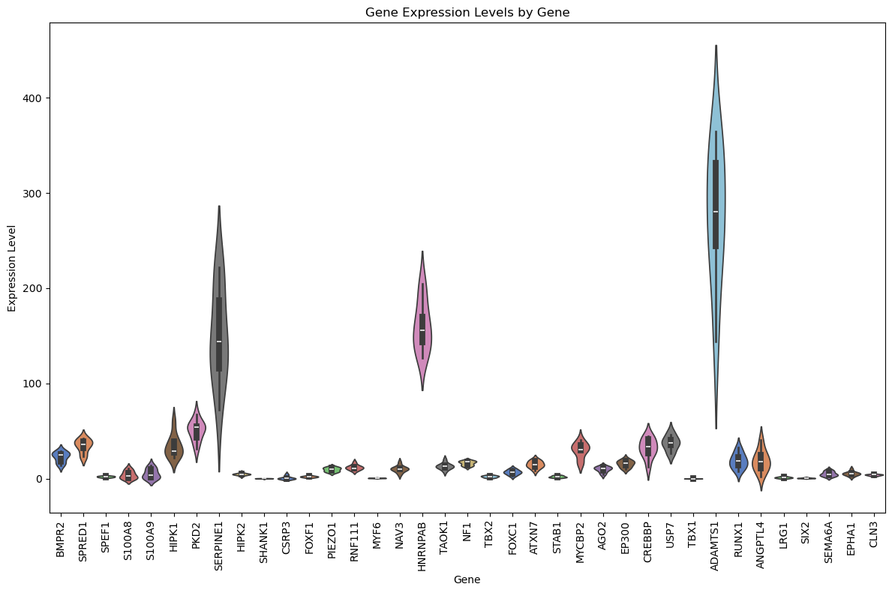
Gene Expression (grouped samples and conditions) for all genes

Slide 6
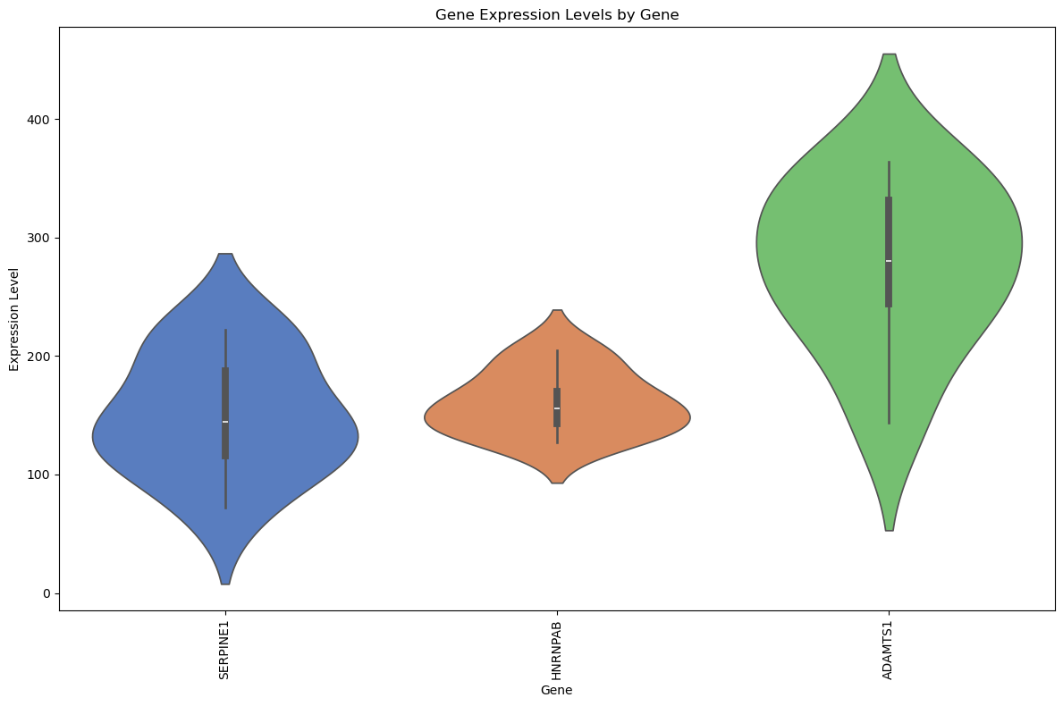
Selecting for top 3 upregulated hits

Slide 7
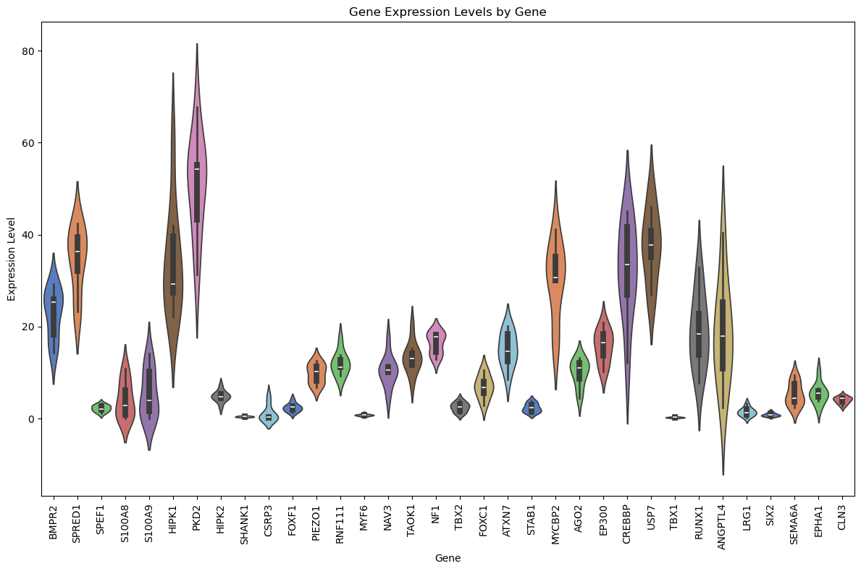
Removing Top 3 Hits
After removing top 3 hits, we can also discern that there are other more variably expressed genes, such as:
BMPR2
SPRED1
S100A8
S100A9
HIPK1
PKD2
ATXN7
MYCBP2
CREBBP
USP7
RUNX1
ANGPTL4

Slide 8
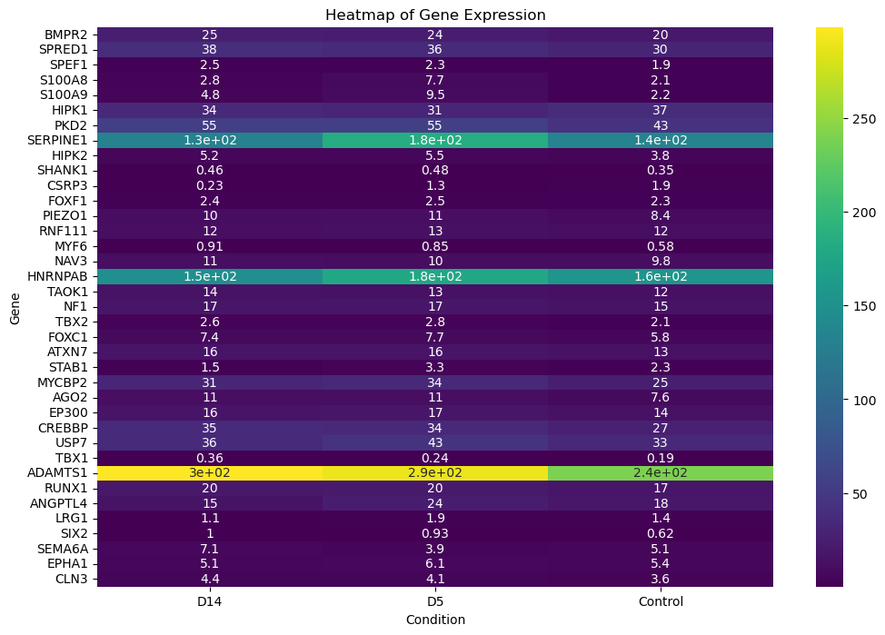
Heatmap for all genes (FPKM)

Slide 9
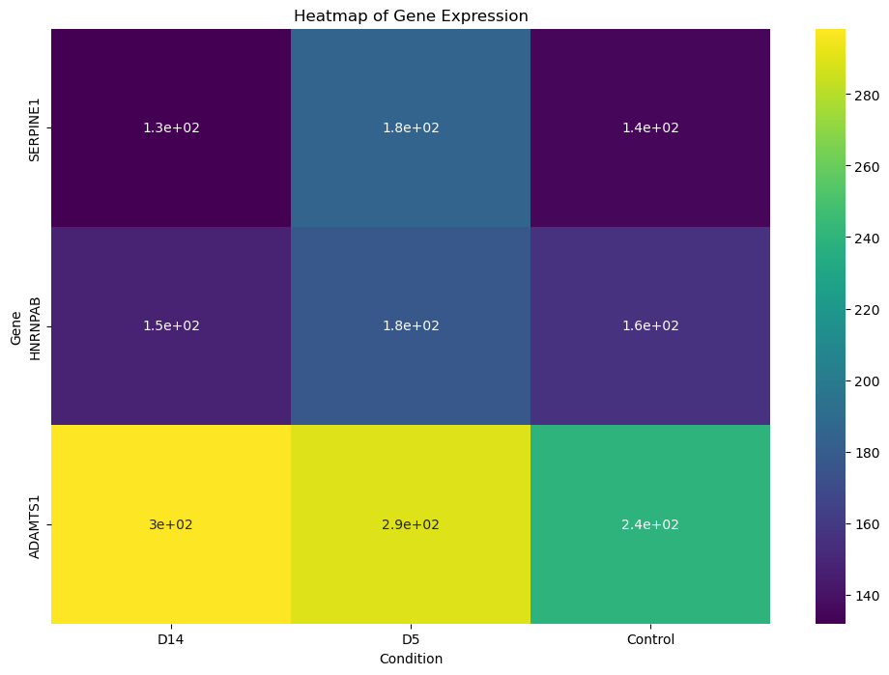
Heatmap for Top 3 Hits

Slide 10
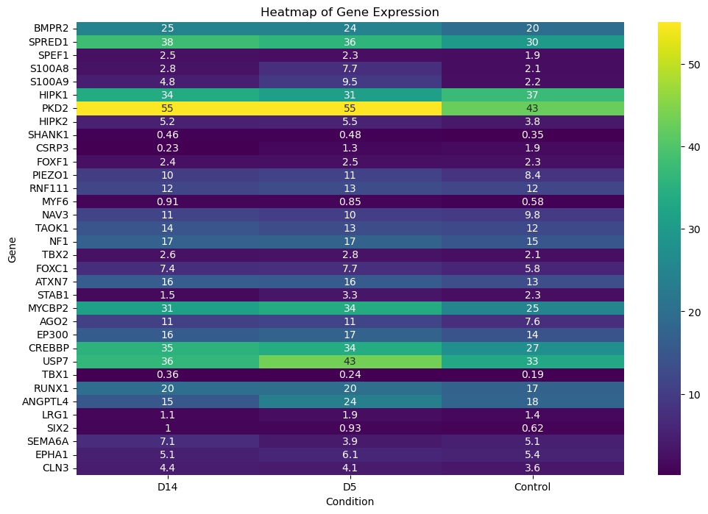
Heatmap Removing Top 3 Hits
After removing top three hits, we can discern upregulated genes
SPRED1
PKD2
MYCBP2
CREBBP
USP7
ANGPTL4

Slide 11
Top Picks of Upregulated Genes Involved in Remodeling, or Regulating Cell Processes
These genes are significantly upregulated in both analyses:
SPRED1:
A negative regulator of the MAPK/ERK signaling pathway, which is involved in cell growth, differentiation, and development. Inflammation and cellular stress often activate the MAPK pathway (likely a marker, and not a cause?)
PKD2:
functions as a calcium-permeable cation channel; changes in intracellular calcium are a common response to cellular stress and damage, which are prevalent in sepsis (a human-specific response exists that includes calcium signaling being impaired)
MYCBP2:
regulates neuronal development, cytoskeletal dynamics, and axonal degeneration; protein degradation pathways like those mediated by ubiquitin ligases can be upregulated in response to stress and damaged proteins (another marker and noncause?) CREBBP:
Chromatin remodeling -> lots of genetic changes occurring during ECM remodeling (another marker and noncause?)
USP7:
regulates the stability of many other proteins
ANGPTL4:
Involved in regulating vascular permeability and angiogenesis. Relevance to Sepsis: It is often upregulated in hypoxic conditions and can contribute to the regulation of vascular response and inflammation, common in septic environments. (seems like it could be a cause of ECM remodeling)

Slide 12
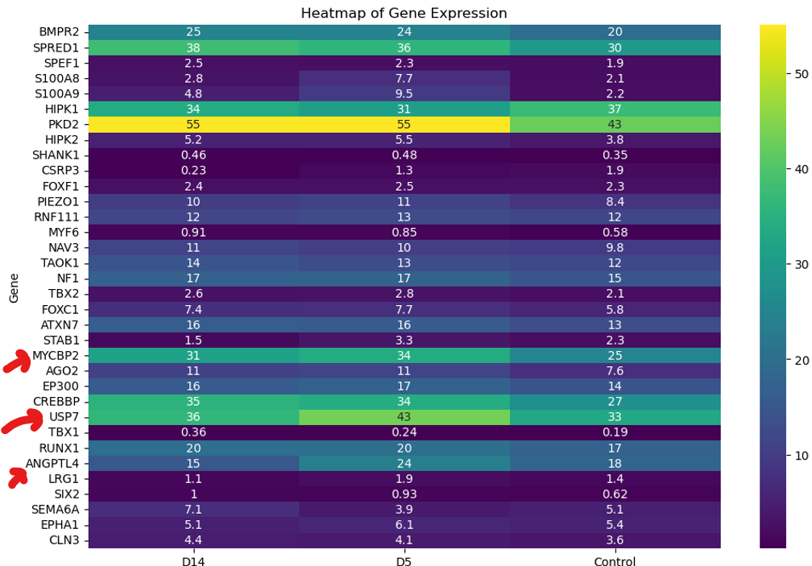
Some genes downregulated after D5
I also found this interesting, several of the genes had decreased counts following the D5 checkup; even the ones that didn’t, were not seen to continue the same upward trajectory to D14.
I’m not sure I can draw any other helpful conclusions without blatant speculation. Excited to move forward and chat!

Slide 13
D14 vs cntl
Muscle Cell Fate Commitment (GO:0042693)
TBX1- controls the development of tissues and organs during embryonic development
MYF6- regulates muscle stem cells (MuSCs) and muscle differentiation/Induces fibroblast differentiation
Regulation Of Animal Organ Morphogenesis (GO:2000027)
TBX1 - …
SIX2 - regulates cell proliferation and migration in many organs (not muscle though)

Slide 14
D5 vs cntl
Positive Regulation Of Cellular Response To Transforming Growth Factor Beta Stimulus (GO:1903846)
CREBBP - provides instructions for making CREB binding protein, which regulates the activity of many genes in tissues throughout the body
LRG1 - promoting neovascularization
EP300 - encodes the p300 protein, which regulates gene activity and is essential for cell growth and division
RNF111 - regulates development, DNA damage, and gene expression
HIPK2 - co-repressor or a co-activator of transcriptional regulators. Dysregulation associated with cancer and neuro diseases
Artery Morphogenesis (GO:0048844)
BMPR2 - Cardiovascular development
FOXF1 - important in the development of pulmonary mesenchyme
NF1 - regulates cell growth and division (cancer), especially in the nervous system
PKD2 – cell interactions and calcium signaling particularly in renal
TBX2 - coordinating cell fate, patterning and morphogenesis of a wide range of tissues and organs

Slide 15
D5 vs cntl pt2
Regulation Of Angiogenesis (GO:0045765)
FOXC1 - involved in the development of the eye, heart, and brain
SEMA6A - guides axon growth and neuronal migration during development. It also plays a role in cell-cell communication and immune regulation.
SERPINE1 - inhibits tissue plasminogen activator (tPA) and urokinase, regulating fibrinolysis (blood clot breakdown) and extracellular matrix remodeling.
HIPK1 - involved in DNA damage response, apoptosis, and transcriptional regulation. It also plays a role in development and stress signaling.
RUNX1 - A transcription factor critical for hematopoiesis and regulation of genes involved in cell differentiation and proliferation.
HIPK2 - involved in DNA damage response, apoptosis, and transcriptional regulation,. Driver of kidney fibrosis
SPRED1 - A negative regulator of the MAPK/ERK signaling pathway, which is involved in cell growth, differentiation, and development
LRG1 - A protein implicated in angiogenesis and immune modulation
ADAMTS1 - involved in extracellular matrix remodeling, angiogenesis, and inflammation
AGO2 - involved in RNA interference (RNAi) and gene silencing through microRNA (miRNA) and small interfering RNA (siRNA) pathways.
STAB1 - involved in the clearance of cellular debris and regulation of immune responses
NF1 - regulates cell growth and division (cancer), especially in the nervous system
ANGPTL4 - involved in lipid metabolism, angiogenesis, and glucose homeostasis. It also plays a role in wound healing and inflammation.
EPHA1 - involved in cell-cell communication, cell migration
Negative Regulation Of Microtubule Depolymerization (GO:0007026)
SPEF1 - regulates cell migration, cell polarity, and the formation of cilia and microtubules (not expressed in muscle)
NAV3 - Cell-cell matrix adhesion and organize the cytoskeleton
ATXN7 - transcription factor that regulates gene expression via chromatin remodeling
TAOK1 - neuronal cytoskeleton regulation, DNA damage response, apoptosis regulation, neuronal maturation, and cortical development

Slide 16
D5 vs cntl pt3
Leukocyte Aggregation (GO:0070486)
S100A9 - regulates inflammation and the immune response (promotes macrophage transition and induces neutrophil release)
S100A8 - regulates inflammation and the immune response (Neutrophil chemotaxis and proinflammatory cytokines)
Positive Regulation Of DNA Demethylation (GO:1901537)
USP7 - regulates the stability of many other proteins
HNRNPAB - plays a role in RNA splicing, nuclear export, and sensing, and regulates axon maturation

Slide 17
D5 vs cntl pt4
Detection Of Mechanical Stimulus (GO:0050982)
CSRP3 - helps maintain muscle structure and function, and sarcomere assembly, and cytoskeleton integrity
PIEZO1 - mechanosensitive ion channel that senses mechanical force and regulates many physiological processes
PKD2 - cell interactions and calcium signaling particularly in renal
Neuromuscular Process (GO:0050905)
CLN3 - autophagy, endocytosis, and lysosomal pH maintenance
MYCBP2 - regulates neuronal development, cytoskeletal dynamics, and axonal degeneration
SHANK1 - helps maintain and form excitatory synapses in the brain

Slide 18
D14 vs D5

Slide 19
Downregulated

Slide 20
Total Downregulated Gene List
TFAP2A
SFRP4
HOXD9
RFLNA
BCKDHA
MCCC2
ECHS1
IVD
MYH3
TPM1
TNNT3
CASQ1
MYOZ1

Slide 21
D14 vs cntl
Skeletal System Morphogenesis (GO:0048705)
TFAP2A - embryonic development, cell division, and apoptosis
SFRP4 - bone development, fatty tissue development
HOXD9 - involved in mediating the transition of cells through the G1-phase
RFLNA - regulates actin networks and forms actin cytoskeletons

Slide 22
D5 vs cntl
Branched-Chain Amino Acid Metabolic Process (GO:0009081)
BCKDHA - breaks down the amino acids leucine, isoleucine, and valine
MCCC2 - leucine and isovaleric acid catabolism
ECHS1 - valine, leucine, and isoleucine and oxidation of fatty acids
IVD - break down leucine, an amino acid, into molecules that can be used for energy
Sarcomere Organization (GO:0045214)
MYH3 - specifies the production of myosin-3, a protein that helps muscles develop and contract
TPM1 - regulates cell shape and strength by stabilizing the thin filament and facilitating actin's interaction with myosin
TNNT3 - produces troponin T, which helps regulate muscle contraction
CASQ1 - regulates calcium levels in muscle cells
MYOZ1 - regulate calcineurin signaling by binding to calcineurin and tethering it to the sarcomere

Slide 23
D14 vs D5

